Slide 1
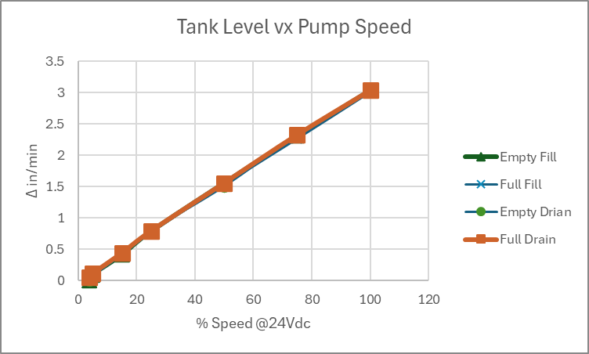
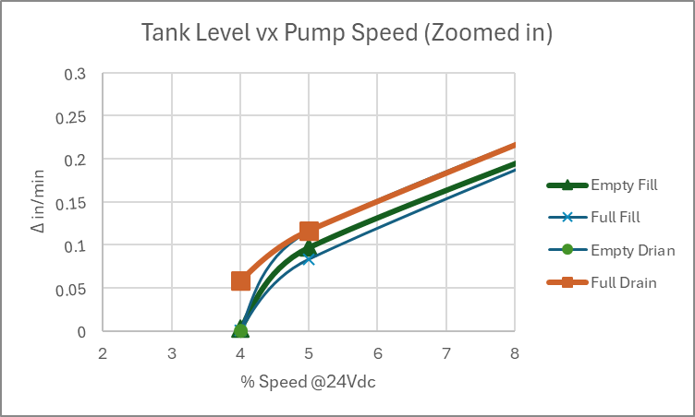
Tank Level Response
Using the Pololu MC18V7 PWM motor controller with Vs set to 24Vdc, The Δ Level was measure for 30 seconds at various percent of max speed (100% duty cycle) for both FILL and DRAIN at near EMPTY and near FULL.
The response has a minor shift at each case but is basically linear down to about 5% resulting in fill rate of about 0.1”/min where the control becomes unstable by 4% as shown in the ‘Zoomed In Plot.
Without doing an extensive fluid analysis, this response is assumed to be adequate for the MLOI application.
Data from mloi:\PM_Folder\_3 Develop\Design Calculations.xlsx sheet Tank. 3/4/2025 R. Ales

Slide 2
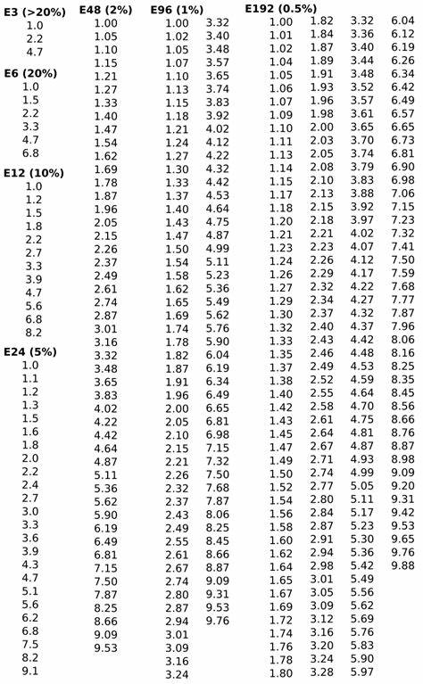

Slide 3
SMT resistor
Reed
Switch
Solder
Pad
PCB
Routed
slot

